Slide 1

WEDEFEND; ANDROID APPLICATION TO MONITOR AND PROTECT FROM REMOTE ACCESS TROJAN
Muhammad Alwi Shihab
Thesis Project
Nanjing Xiaozhuang University and Esa Unggul University
Presentation Inspired by DEFCON Speakers

Slide 2

WHOAMI
Security Analyst Amateur
Red Team, Blue Team, Grey Hat
IT Blogger Since 2010
Entrepreneur Since 2014
https://github.com/wishihab
http://travismarkshihab.blogspot.com/
http://dota2storeid.com/

Slide 3
BACKGROUND
EXPERIENCES
EXPERIMENT
PREVIOUS PROJECT APPLICATION
DISCUSS WITH PROFESSIONAL MALWARE ANALYST
https://github.com/wishihab/WeDefend

Slide 4
RATROJAN MALWARE
PUBLIC FREE
COMMERCIAL
COMMERCIAL CRACKED
PRIVATE
WHO USE IT?
GOOD PEOPLE
BAD PEOPLE
ORGANIZATION
COMPANY
GOVERNMENT
Notes:
A remote access Trojan (RAT) is a malware program that used for malicious purposes, this Trojan inspired by remote access tools.
These day, a million of remote access Trojan has been created which they free or paid with multiple operating system as target.

Slide 5
PROBLEM IDENTIFICATION
HOW TO MONITORING ANDROID FROM REMOTE ACCESS TROJAN?

Slide 6
THEORY
Network Activity Based
Permission Usage Based
Encryption Based

Slide 7
PURPOSE
STUDY
MONITOR AND PROTECT PRIVACY
DO, REALIZE IDEA IN MY HEAD!
Notes:
Obsession and Paranoid

Slide 8
PREVIOUS PROJECT BY RESEARCHERS
CrowDroid by Burguera 2011
APK Auditor by Kabakus 2015
NAM APP by Acosta-Guzman 2015
Notes:
BehaviorBased Analysis
Permission Based Usage
Network Activity Monitor

Slide 9
WEDEFEND
WeDefend is application based on java programming language with features as check network activity, permission usage, file encryption to against and also protect user data from remote access Trojan malware in android operating system. This application will help a user to increase their privacy awareness.
Note: This application is not an antivirus, this app can't remove and detect Remote Access Trojan automatically, this app will against Remote Access Trojan from amateur to normal skill attackers.
Notes:
This application contains a several function to identify the user android. With step by step
Higher level skill.

Slide 10

ADV Video

Slide 11
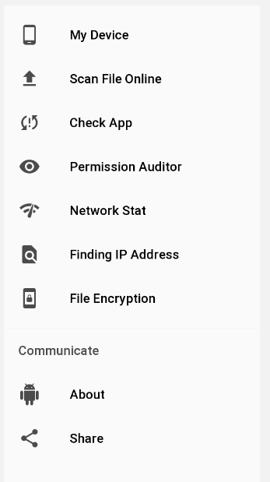
FEATURES
MY DEVICE
SCAN FILE ONLINE
CHECK APPLICATION
PERMISSION AUDITOR
NETWORK STATUS
FINDING IP ADDRESS
FILE ENCRYPTION
https://github.com/wishihab/WeDefend-Android

Slide 12
SHOWING APPLICATION ON EMULATOR

Slide 13
SIMULATION WITH REMOTE ACCESS TROJAN BY AHMYTH + FLAPPYBIRD VS WEDEFEND
https://github.com/AhMyth/AhMyth-Android-RAT
https://github.com/wishihab/Android-RATList

Slide 14
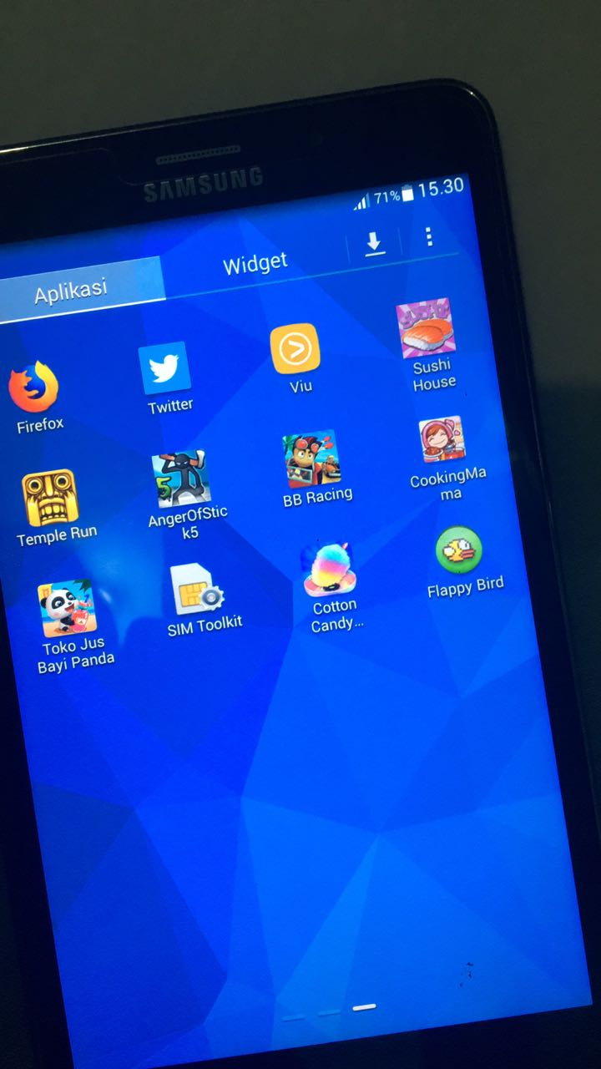
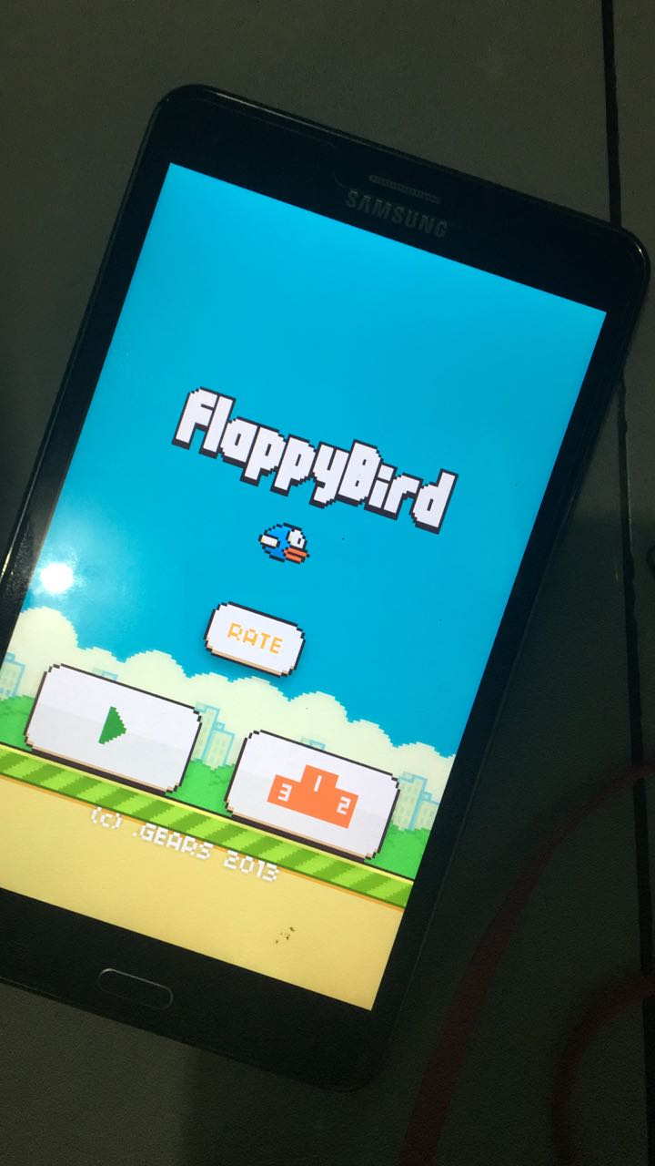
Home Phone Tablet; Social Engineering

Slide 15
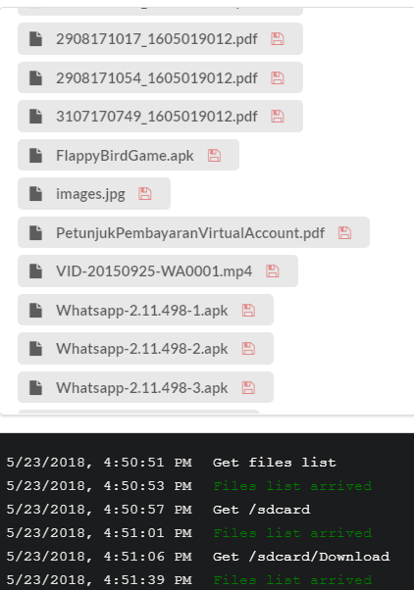
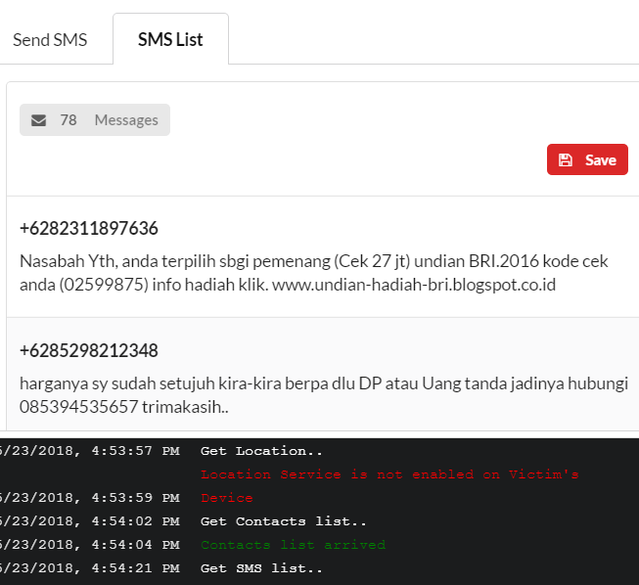
PWND!

Slide 16
SUGGESTION OR NEXT
DETECT THE BEHAVIOR OF APK FILE (by Sam Bowne)
IDENTIFY APPLICATION NAME ON IP ADDRESS
AUTOMATICALLY CATEGORIZE WHITELIST IP ADDRESS
ADD UNINSTALL FUNCTION IN APP
IMPROVE THE SECURITY ENCRYPTION
Notes:
Sam Bowne, IT Security Profesional . See Samsclass.info/contact

Slide 17
CONCLUSIONS
WEDEFEND APPLICATION IS USEFULL APP TO MONITOR AND PROTECT ANDROID FROM REMOTE ACCESS TROJAN, BASED ON STEP BY STEP FEATURES.
Notes:
The best way, why? Because RAT is about C&S with internet connection
Updating system device to patch the vulnerability and malware code (example ive try to install on news security patch)
Care from unknowns app, feel like never install it for app list and I though this app don’t need this permission ex; flappybird don’t need camera
Even the attacker get the file but it’s encrypted, they can’t read or open it

Slide 18
QUESTIONS?

Slide 19
TIPS; How to Protect Yourself??
NEVER INSTALL APP FROM 3rd PARTY STORE.
KEEP YOUR DEVICE ALWAYS UP-TO DATE WITH LATEST SECURITY PATCHED.
KEEP "unknown sources" DISABLE WHILE NOT USE IT.
ENSURE THAT YOU HAVE ALREADY OPTED FIRST ANDROID SECURITY.
PROTECT YOUR DEVICE WITH PIN, PASSWORD OR FINGERPRINT.
USE MY APP TO MONITOR AND PROTECT!

Slide 20
THANK YOU

